Slide 1
‘Basti’ by Intizar Hussain
Topic - The Child's Perspective in 'Basti'
Name - Ankita Saha
Roll - 1802064
Registration No. - 1061821100176
Semester - VI
Course Name - Partition Literature

Slide 2
Portrayal of an Integrated, Joyous yet Obliged Childhood of Zakir
Point
Context
Zakir’s fascination with mythologies.
Inquisitive nature of little Zakir
It makes his days very much exciting and colourful to pass with. Fiction becomes facts and those facts become his way of ratinonalizing.
Apparently simple questions but with enormous implications. Different answers create doubts and confusions .

Slide 3
Portrayal of an Integrated, Joyous yet Obliged Childhood of Zakir
Point
Context
Communal harmony in Rupnagar
Changes witnessed by the child
Active and delightful childhood
Forgetting the Hindu-Muslim division people of Rupnargar live in an uncomplecated milieu.
Small nuances of everyday life become important. People gradually adapt to changes.
So simple yet colourful childhood leading with activities.

Slide 4
Portrayal of an Integrated, Joyous yet Obliged Childhood of Zakir
Point
Context
Significance of digging graves
Journey to Vyaspur
Zakir and Sabirah digging their own graves and trying to fit into each other’s grave are predictive of the future.
Journey to Vyaspur looks very big to the child. Zakir’s excitement and Sabirah’s sorrow. Difference between children and adults in expressing emotions.

Slide 5
Portrayal of an Integrated, Joyous yet Obliged Childhood of Zakir
Point
Context
Hussain’s motives for choosing child’s prespective in narration.
The child’s perspective helps to see the change that comes over adults’ world. Children’s uninhibited response differs from adults’ inhibitions. Represents gradual movement of circumstances.

Slide 6
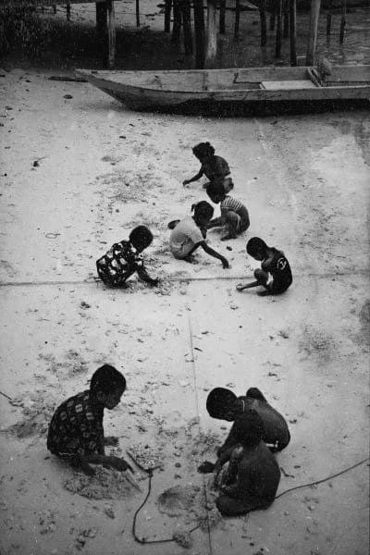
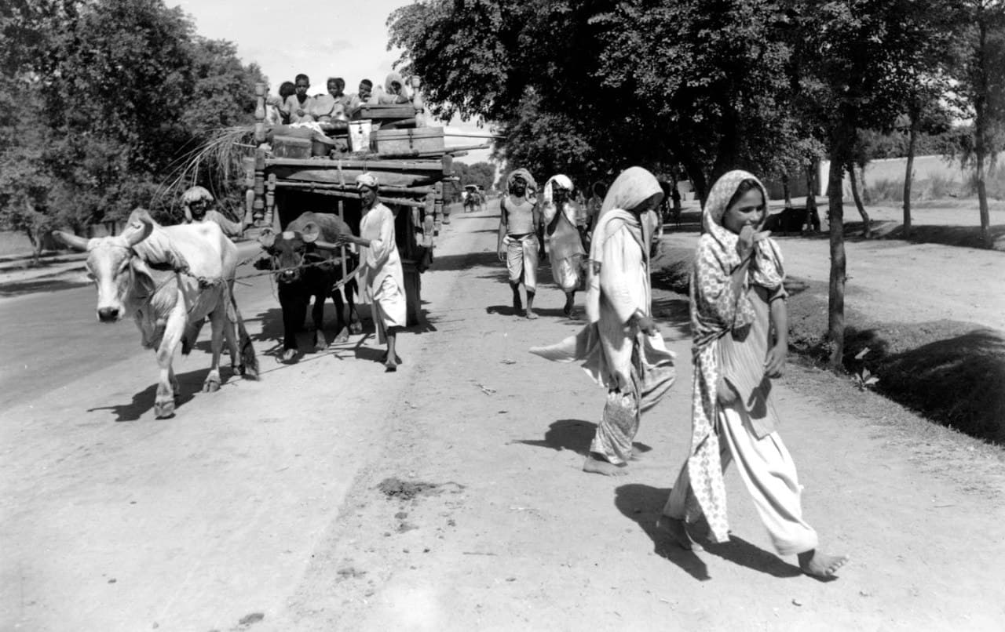
Thank You

