Slide 1
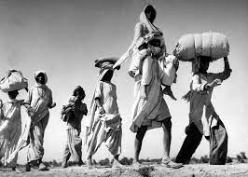
BASTI AS A DIASPORIC NOVEL PRESENTED BY DEBLISA MALLICK

Slide 2
WHAT IS A DIASPORA? 1) The mass dispersion of a population from its indigenous territories, specifically the dispersion of the Jews. 2) Whilst the word was originally used to describe the forced displacement of certain people, "Diaspora" is now generally used to describe those who identify with a "homeland", but live outside of it. THEN, WHAT IS A DIASPORIC NOVEL? This kind of novel deals with the following things:- 1. Forced Displacement of People 2. Alienation 3. Loneliness 4. Nostalgia 5. Readjustment 6. Adaptation

Slide 3
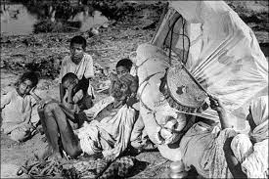
'Exhaustion brought them to their knees' Source: Scoop Whoop

Slide 4
BASTI & THE WOES OF DIASPORA 1) Zakir, the protagonist, takes us on the journey through his memories. 2) Suffering shown through nostalgia, longing and devastation of a nation upon partition. 3) Distorted chronology shows the disturbed state of Zakir’s mind

Slide 5
CHILDHOOD HAVEN OF ZAKIR: RUPNAGAR 1) Located in Eastern Uttar Pradesh, India. 2) Rupnagar translates into “City of Beauty”- A utopian society. 3) Husain’s idealistic vision of what Hindu-Muslim culture was or should have been. 4) Interminglinging of Hindu-Muslim’s culture. 5) They co-exist peacefully ; respect each others culture. 6) Zakir grows up learning two stories about world’s creation; one from Bhagat- ji and another from his Abba Jan 7) Finds both the stories amusing and believes both are true.

Slide 6
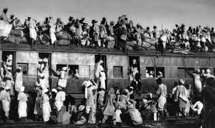
Million of refugees in Ambala Source: India Times

Slide 7
LEAVING RUPNAGAR & MIGRATION TO PAKISTAN 1) Zakir and his parents leaves Rupnagar and settles in Vyaspur for a short time. 2) For the first time he gets the taste how a Diaspora feels like. 3) Feels like he had left his childhood in Rupnagar. 4) Then in 1947, they have to leave for Pakistan due to the partition. 5) They leave behind their home and relatives. Meanwhile, Zakir leaves behind his friends and childhood love, Sabirah.

Slide 8
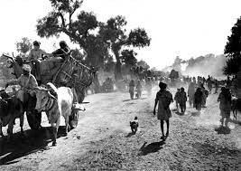
People leaving their villages, hoping they would come back. Source: Scoop Whoop

Slide 9
PANGS OF DIASPORA, LONGING AND NOSTALGIA. 1) Zakir’s father’s longing to get buried beside the graves of his forefathers. 2) Zakir’s longing for Neem trees and his reminiscing about his childhood friends and love, Sabirah. 3) Afzal’s grandmother longed to go back to her homeland.

Slide 10
THANKS FOR WATCHING

