Slide 1
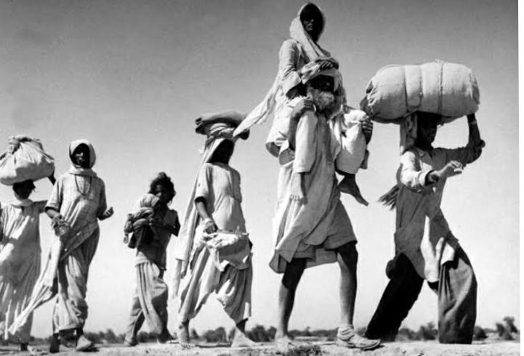
BASTI
Creation and Doomsday as tropes within the narrative
Haimantika Dutta
Roll no: 1802080 Sem-VI DSE5
Reg no: 1061821400190

Slide 2
Creation and Doomsday in Basti
In 1071
Human settlement— At the begining of Intizar Hussain‘s Basti— a urdu word that refers to a human settlement of any dimensions.
Mythic even mystic vision of harmony— Basti means any space, from the most universal question at the heart of the book is how to constitute a common world.
Mythic stories and the creation of world
Creation of new country— The creation of India and Pakistan and after the Bangladesh liberation war in 1971.

Slide 3
Creation and Doomsday in Basti
Memory
Creation of world of lonliness— the new country of Pakistan is born, separating Zakir once and for all from the woman he loves and in a jagged and jarring sequence of scences.
Plague— Death toll of commoners being victims of Plague, is also linked with doomsday.
Creation of cruelty— The nature of people become cruel in the post partition time.

Slide 4
Creation and Doomsday in Basti
Creation of two separate nation— The separation of India and Pakistan is metaphorically compared with the mythical brothers Cain and Able and even their distinction of full brother and stepbrother a mentioned in a doubtful way.
Violence — Neumerous destruction, killing of people, rape of women, ablaze houses, refuges, mass transformation.
Totalitarian principals— The mass oppression by the state power.
Karbala war

