Slide 1
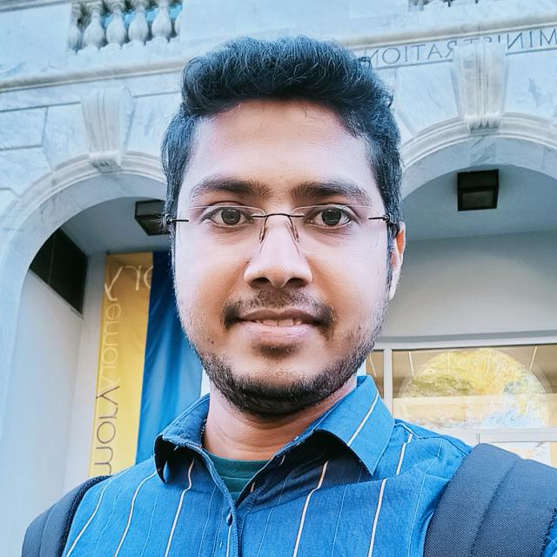
A one-day webinar organized by the Department of Chemistry in collaboration with IQAC, Barasat of Govt. College
Speaker
Dr.Tapas Haldar
Post doctoral fellow,
Emory University, USA
Topic: Measuring biological interactions using spectroscopic techniques
Date: 24th February, 2022 (Thursday)
Time : 11 am
Google link : https://meet.google.com/fmw-fryd-cez
Patron
Dr. Samar Chattopadhyay
(WBSES)
Principal, Barasat Govt. College
Convenor
Dr. Prabir Bhattacharya
Head, Department of Chemistry,
Barasat Govt College

